Slide 1
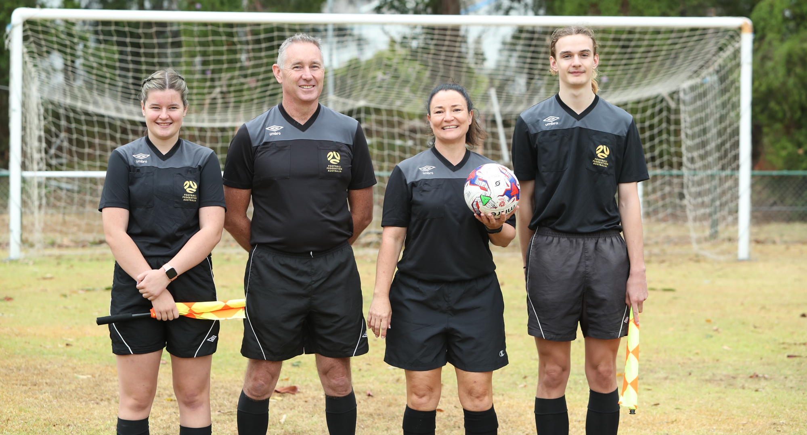
APRIL 2020 NEWCASTLE REFEREES COACHING SESSION
Notes:
INSERT MACQUARIE, NEWCASTLE, HUNTER VALLEY VERSION

Slide 2
PREPARING FOR MATCHES
Managing your unavailability
Checking your appointments
Packing your bag
Arriving at the ground
Pre-match duties

Slide 3
MANAGING YOUR AVAILABILITY
The unavailability deadline on MatchRef is 11:59pm on Sunday each week. Please ensure, where possible, that all unavailability for the week ahead has been put into MatchRef before this deadline.
We understand that there may be reasons why you become unavailable for appointments after this deadline e.g.
You become unwell
You become injured
Something comes up at late notice (Work, Family commitments etc.)
If you become unavailable after the MatchRef deadline or after appointments have been released please do one of the following:
Email Rachel Sager via rsager@macquariefootball.com
Ring or Text Message Rachel Sager on 0484 094 123
IF YOU BECOME UNAVAILABLE FOR YOUR APPOINTMENTS
AT SHORT NOTICE – YOU MUST RING RACHEL SAGER

Slide 4
MANAGING YOUR AVAILABILITY
Notes:
Home screen once the referee has logged on – Calendar shows an overview of appointments and availability
My Unavailability section is used to enter and view unavailability

Slide 5
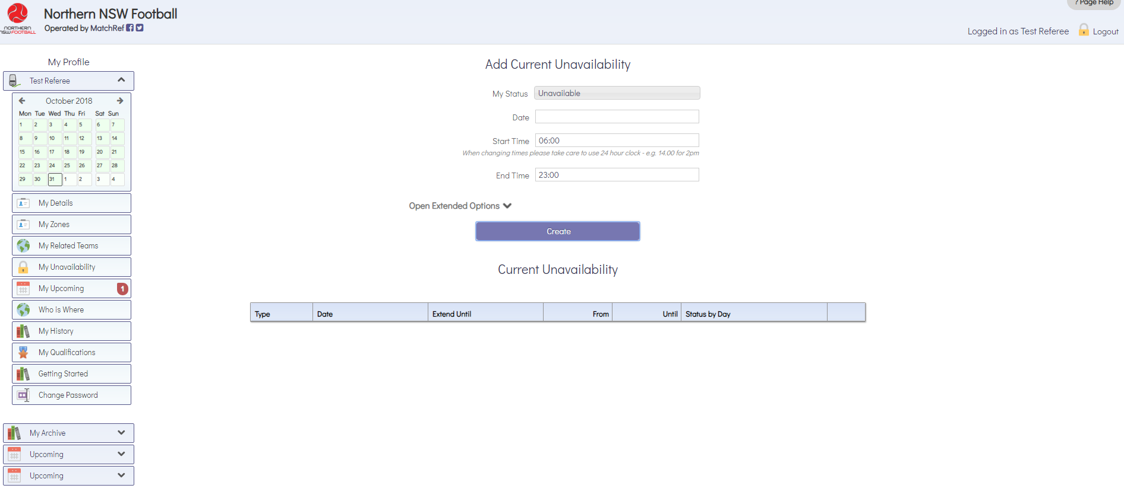
MANAGING YOUR AVAILABILITY
Notes:
View when opening the ‘My Unavailability’ section

Slide 6
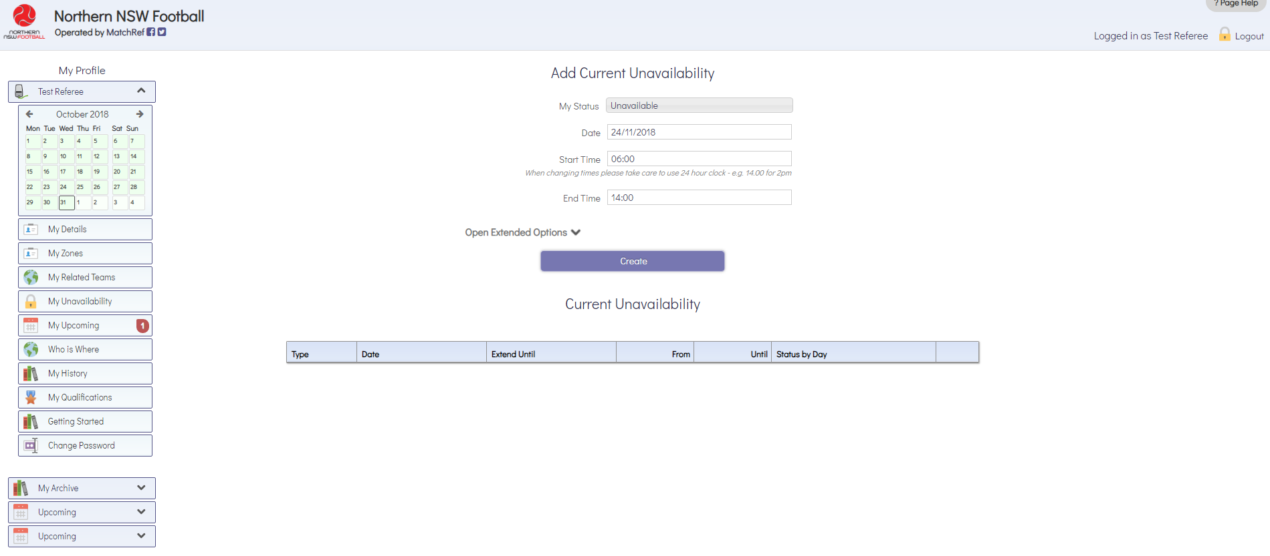
MANAGING YOUR AVAILABILITY
Notes:
Example of how to enter unavailability for a specific time period on one day
In this case, Referee plays cricket on Saturday 24 November but will be finished and able to referee any matches starting at 2pm

Slide 7
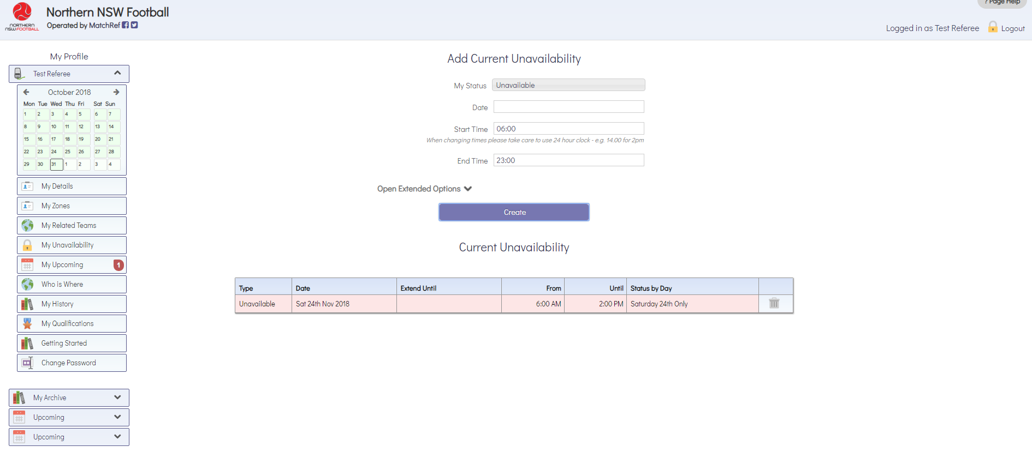
MANAGING YOUR AVAILABILITY
Notes:
Once the referee selects ‘Create’ the unavailability entry can now be seen

Slide 8
MANAGING YOUR AVAILABILITY
Notes:
Example – Referee is unable to referee for the entire day on Sunday 25 November
MatchRef defaults the times to be 6am – 11pm

Slide 9
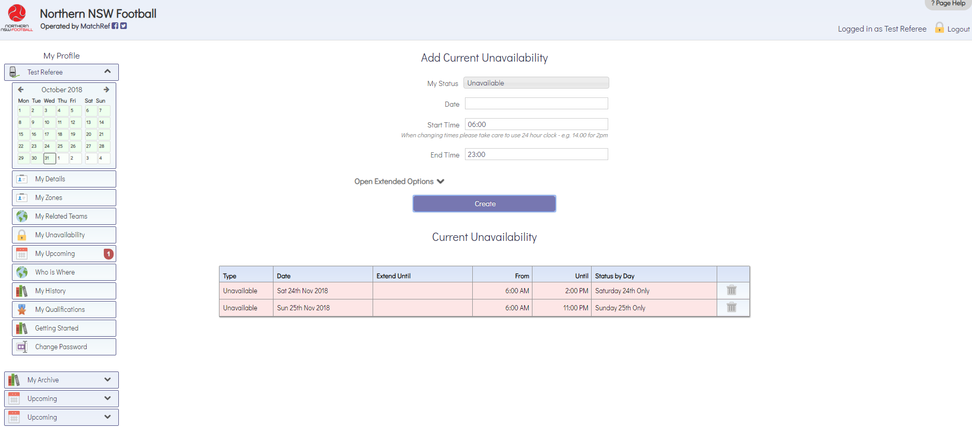
MANAGING YOUR AVAILABILITY
Notes:
Entry for an entire day (25 November) can now be seen

Slide 10
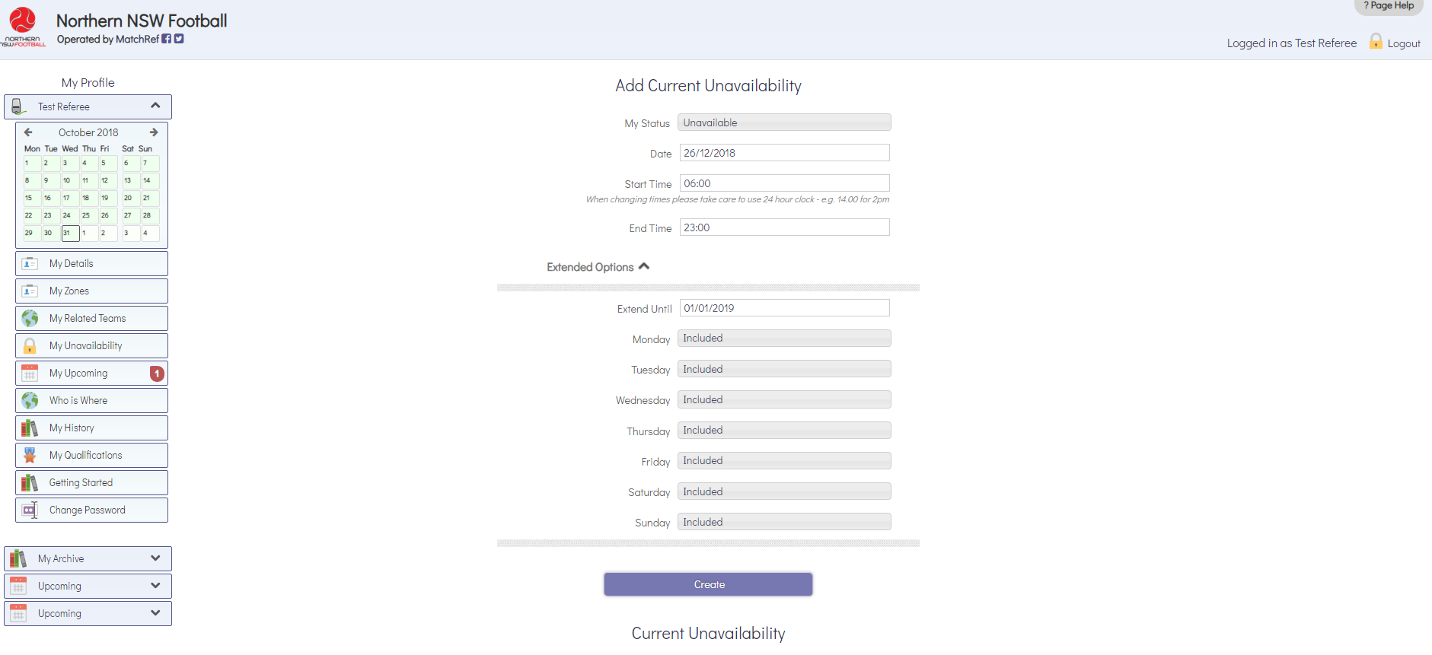
MANAGING YOUR AVAILABILITY
Notes:
Example – Making yourself unavailable for an extended period
In this case the referee may be going away and is unavailable from 26 December until 1 January (inclusive)
All days must be ‘included’

Slide 11
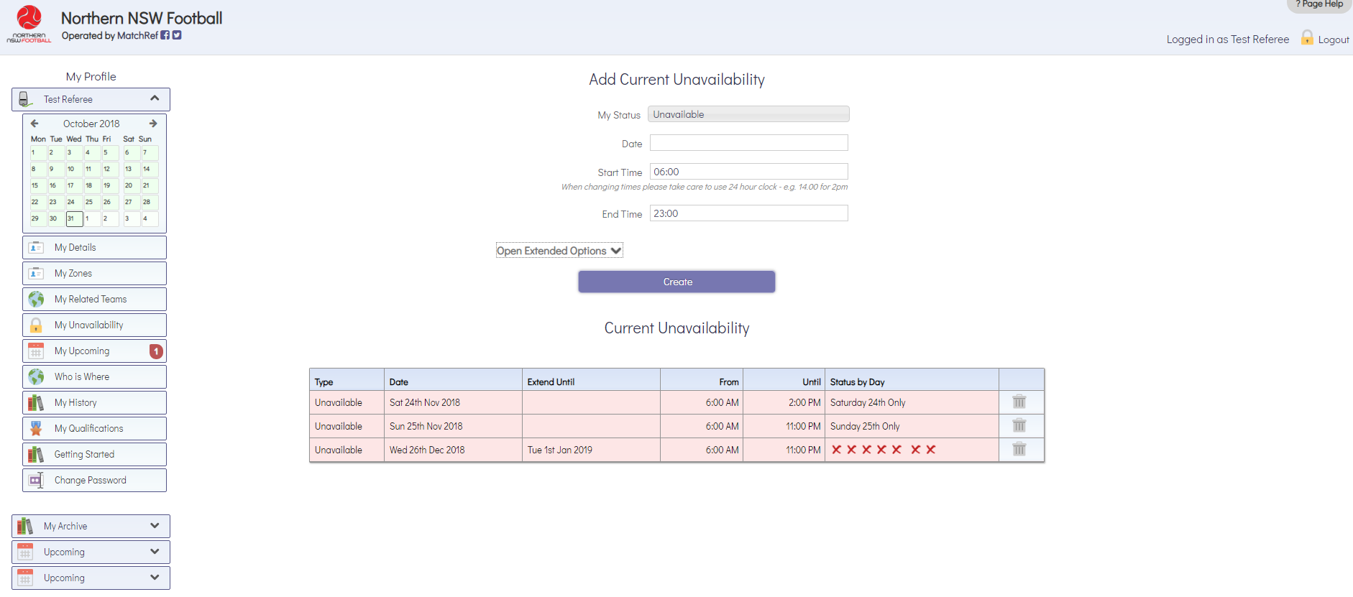
MANAGING YOUR AVAILABILITY
Notes:
Entry for extended period (26 December – January 1) can now be seen

Slide 12
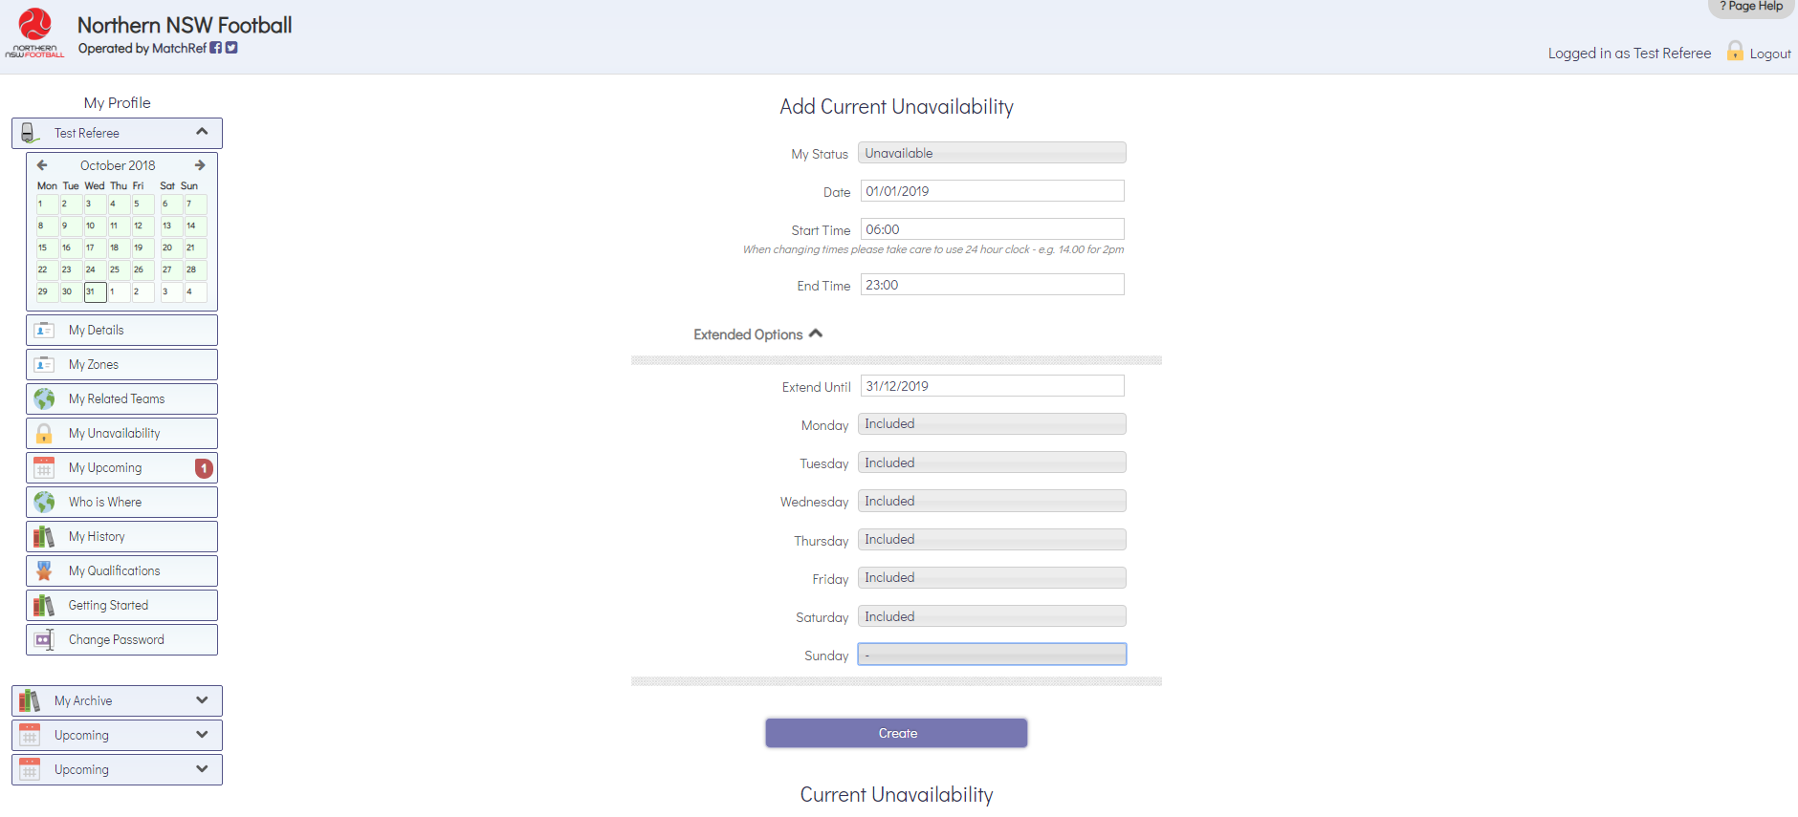
MANAGING YOUR AVAILABILITY
Notes:
Example – A referee who only officiates with Northern NSW Football on a Sunday
Selects the dates covering the entire season but does not include Sunday – this is done by clicking on the included button for that day.

Slide 13
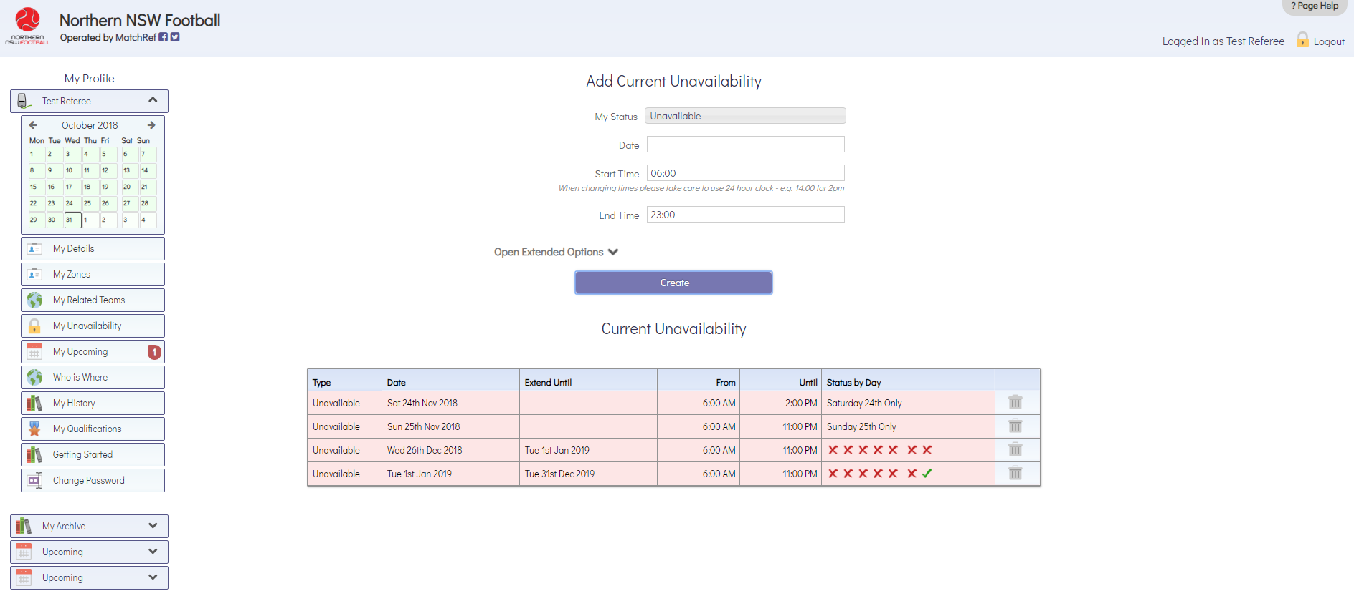
MANAGING YOUR AVAILABILITY
Notes:
Entry for entire season can now be seen – notice the tick indicating Sunday’s are still available

Slide 14
MANAGING YOUR AVAILABILITY
Notes:
Look at the calendar – Yellow indicates partially unavailable
– Red indicates unavailable for the entire day

Slide 15
MANAGING YOUR AVAILABILITY
Notes:
Mark on 25 December shows that the referee has been appointed to a match on this day
Extended period shown in red as per unavailability entry

Slide 16
MANAGING YOUR AVAILABILITY
Notes:
Season long unavailability is shown leaving Sunday’s blank as per entry

Slide 17
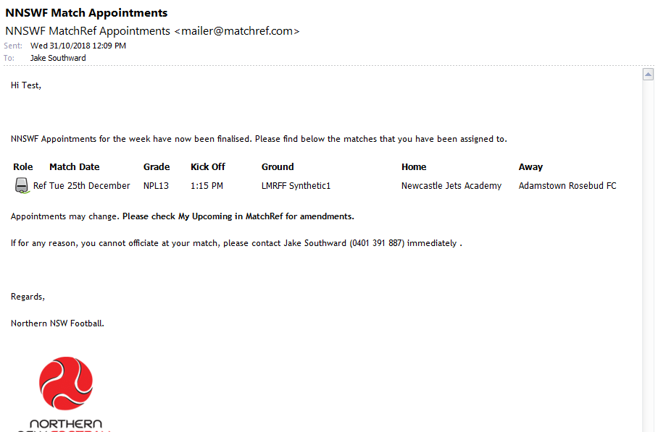
CHECKING YOUR APPOINTMENTS
Notes:
Once the appointments have been released you will receive an email like this to your primary email showing on MatchRef.
This email does not give you all details so it is important to check ‘my upcoming’ on MatchRef

Slide 18
CHECKING YOUR APPOINTMENTS
Notes:
The ‘My Upcoming’ section can be found below the My Unavailability.
Once the appointments have been published, the number of matches you have is shown next to this button

Slide 19
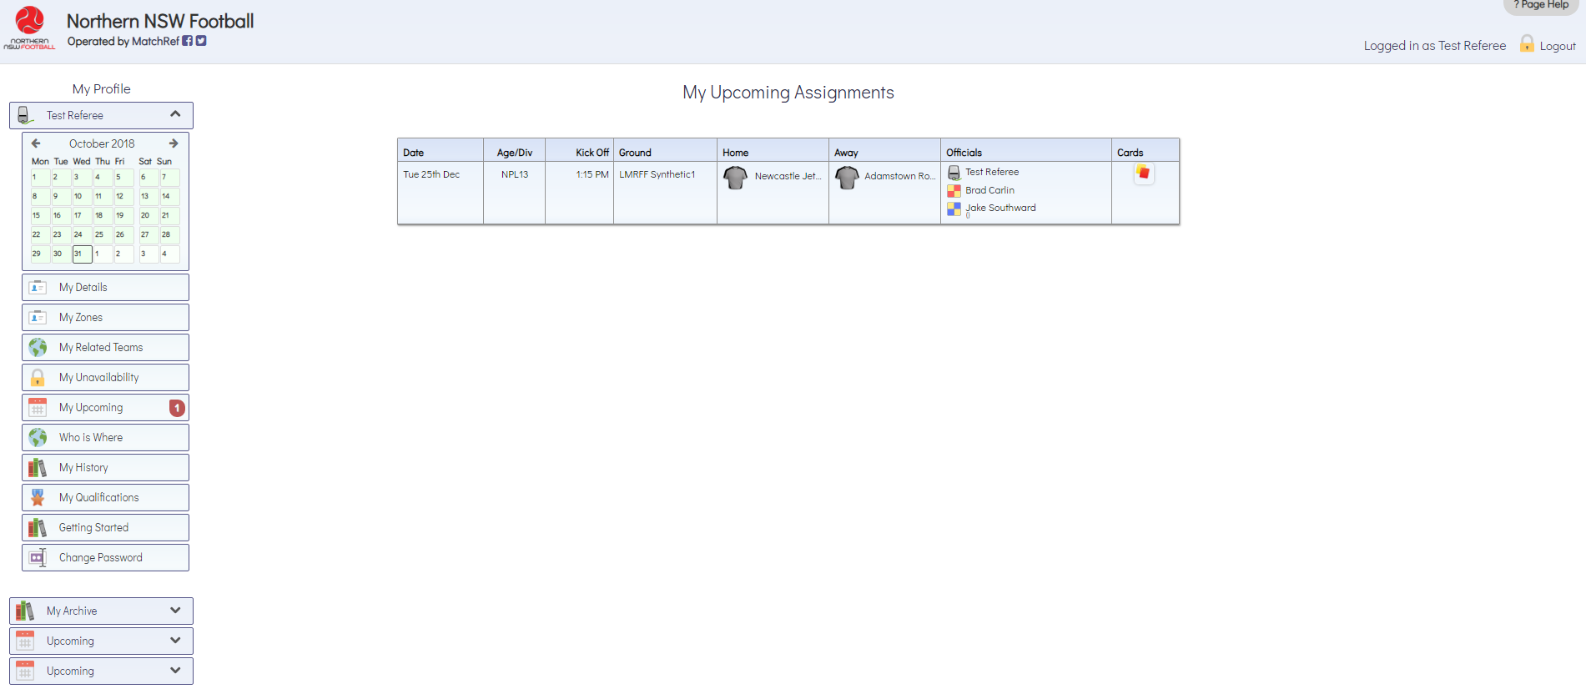
CHECKING YOUR APPOINTMENTS
Notes:
Once you have clicked ‘My Upcoming’ you will be shown this view.
It gives you full details of the match including the names of your assistant referees and assessor (if one has been appointed)
This section will also show you any changes to your appointments.
It is essential that you check your appointments in this view shortly after you receive them – this notifies us that you have seen your appointments.
Check this view the night before your matches in case there have been any last minute changes.

Slide 20
PREPARING FOR YOUR MATCH
Fill out your match cards with teams, date, kick off time, venue etc. as you already know all of this information
Look up details for the competition you are refereeing e.g.:
Half length
Half-Time length
Size of match ball
Number of team officials or subs allowed
Substitution/Interchange rules
Find the address of the ground you are officiating at then figure out how you will get to the ground and how long it will take

Slide 21
PACKING YOUR BAG
Black shoes to referee in (Boots, joggers, turf shoes etc.)
Umbro Socks
Umbro Shorts
Umbro Shirt/s (Black is compulsory, colours if you have them)
Jacket (Optional)
Flags
Whistle
Watch (May need a spare)
Pens
Match Record Cards or Notebook
Red and Yellow Cards
Coin
Notes:
Additional Items to possibly pack:
Laws of the game book
Handbook (Containing policies)
Spares of all items

Slide 22
ARRIVING AT THE GROUND
Arrive at the ground at least 30 minutes prior to your first match commencing
Ensure you are dressed appropriately when arriving at the ground. Below are the acceptable options:
Your full, black, Umbro referee uniform
A Referee polo shirt, neat shorts/pants and fully enclosed shoes
Locate the Referee Room/Shed. If you can’t find it ask a duty officer or club official.

Slide 23
FIELD INSPECTION
Check the field of play as a team (if you have assistant referees). You should check for the following:
All required field markings are clear and appropriate
The field surface isn’t dangerous
There are no holes in the nets
There are 4 corner flags that are the appropriate height
The technical area is clearly marked
If there are any issues with the field of play let a duty officer or home club
official know straight away – use common sense to help to fix the issue
(if possible) and get the match played in a safe manner

Slide 24
PRE MATCH INSTRUCTIONS
Ensure that before each game you give pre-match instructions as every referee expects different things. Even when there is very little time between matches your instructions should touch on:
What to do if there is a penalty kick (positioning of your AR, who focuses on what)
What your AR should do if they see an offence which warrants a penalty kick
Foul throw ins (who should watch what)
What to do if there is a mass confrontation
What the AR should do if they have seen something worthy of a caution or
send off
Match Records – details during the Match the ARs need to record
What to do when a goal is scored (including writing in your book)

Slide 25
COLLECTING THE TEAM SHEET
Collect the team sheet prior to walking out the commence the match
Ensure that all players who are taking part in the match have signed next to their printed name and have written their number in the correct spot.
If someone is late, ensure their name is printed on the team sheet and get them to sign and write down their number before they enter the field
The AR1 (or the Referee if there are no assistants) should keep the team sheet with them throughout the match (take a plastic bag in case of wet weather)
Any team official who will be in the technical area during the match must be listed on the team sheet

Slide 26
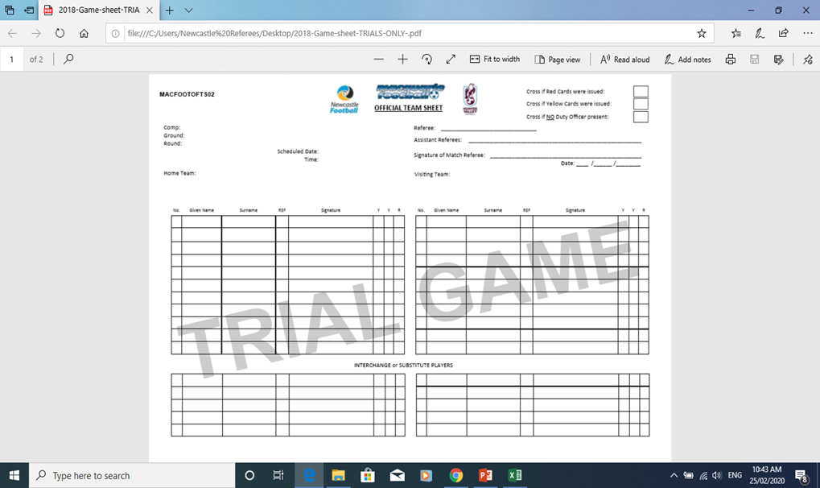

Slide 27
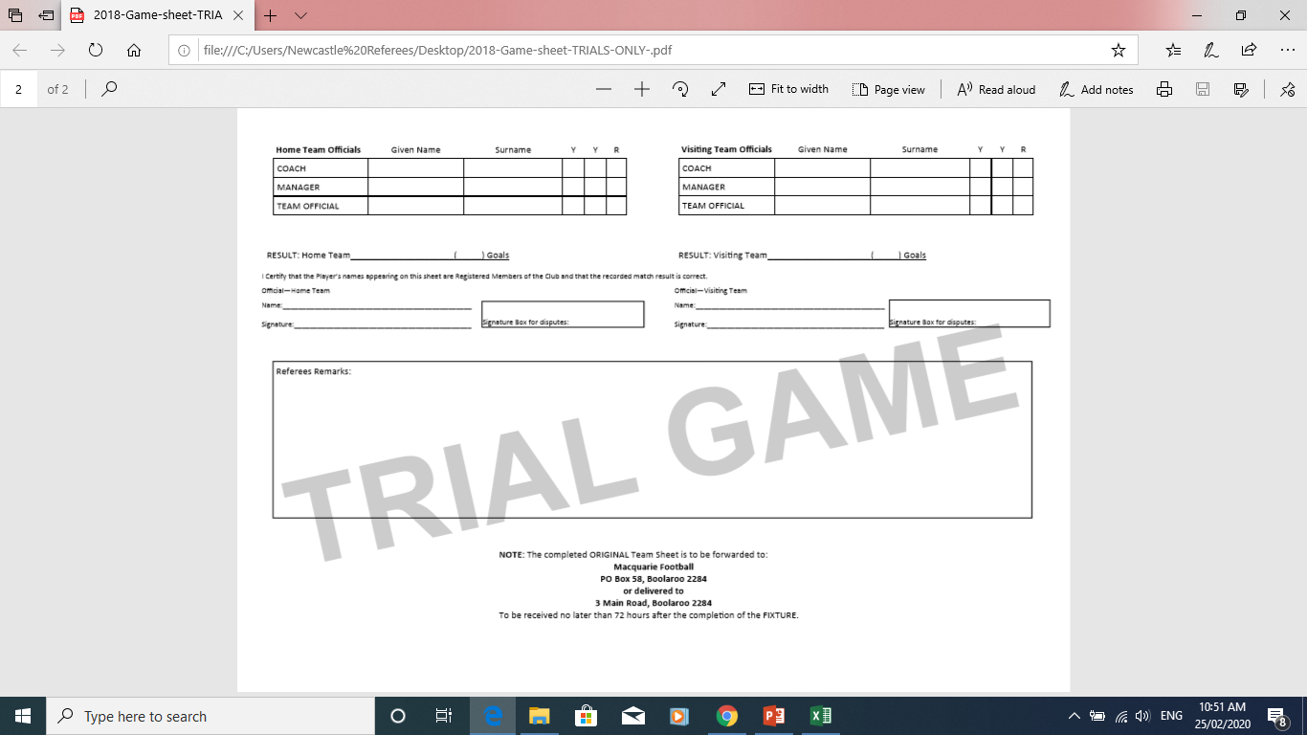

Slide 28
CHECKING PLAYERS EQUIPMENT
Match Officials should check the players equipment prior to the beginning of the match. This includes:
Studs – ensure they are not sharp and dangerous
Shin pads – are worn
Rings and bracelets – Can’t be worn even if taped over (excluding medical alert bracelets)
Piercings – Must not be worn, cannot be taped over (We are only worried about areas we can see – Belly piercing is not our concern but a taped up nose piercing is

Slide 30
Referees Match Notes
Example
Date & Time of Match
Home Team: All Stars | Away Team: Thunders
Colour: Red and White | Colour: Black and Blue
Toss Win:
Kick Off:
Score: 1 | Score: 1,1,1
Cards & Time: Y-2--- Dissent No:10 30th min Y-2--- Dissent No;10 39th min 2nd yellow Card- Send off | Cards & Time: Y-4 – Delay restart No: 3 70th min Y-1—Unsporting Behaviour No: 7 75th min
Comments: R-7 No:10 Sent Off 39th min. ( report to follow. Gather all info. AR may need to make report also. Take pic of sheet.) | Comments: (Ensure the yellow cards are entered on the Team sheet against correct player/ team official)
Away Team call
xxx
xxx

